Slide 1
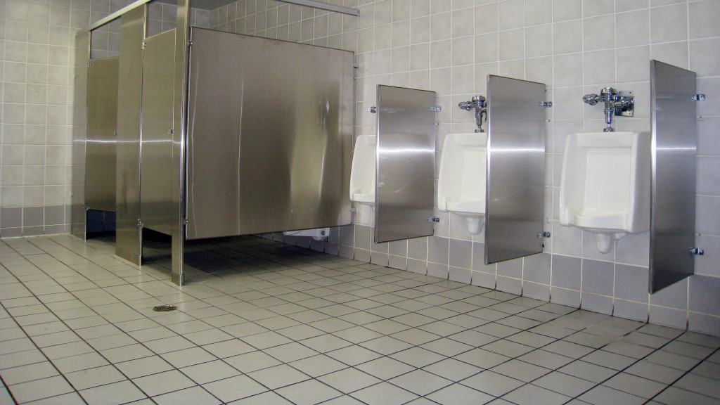
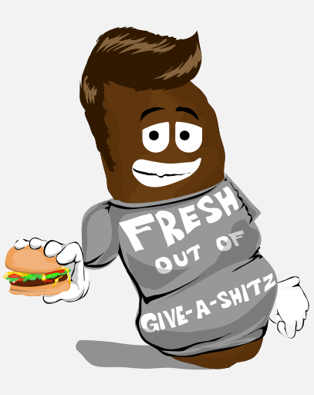
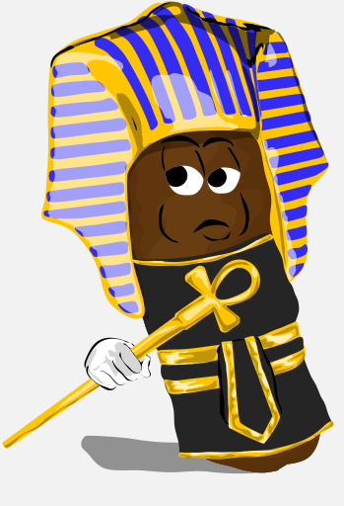
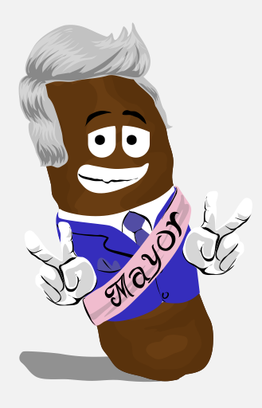
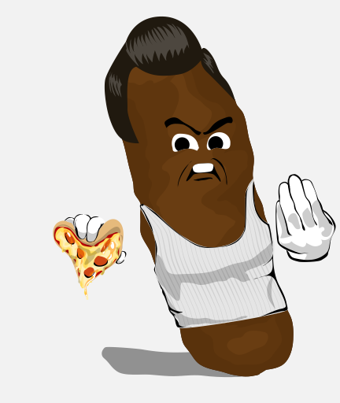
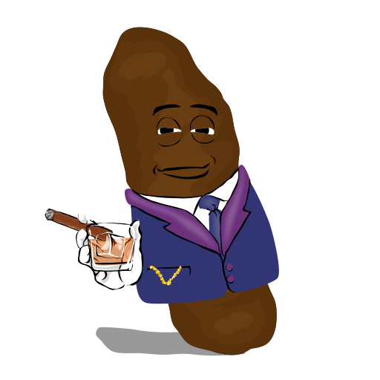
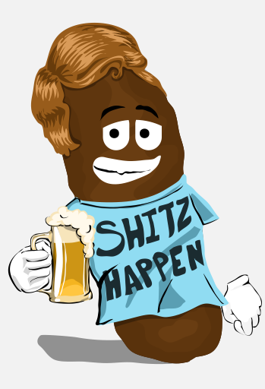
The Shitz
Click to Mint

Slide 2
The Shitz are a species of Homo feceans that comprise a complex society of 4,444 Shitizens. Each Shitizen is unique and represents a different character in Shitzville which exists on the Solana blockchain.
There are many different kinds of Shitz. The Shitz can be male or female and come in many shitzy colors, just like human shit. All Shitz are well-formed and firm yet squishable. The Shitz have been created to make you laugh because humor is great medicine to help us get through these Shitzy times. A portion of Shitz sales will go to gastrointestinal disease charities and the Shitzville Community Bank for future Shitzy giveaways and projects!

Slide 3
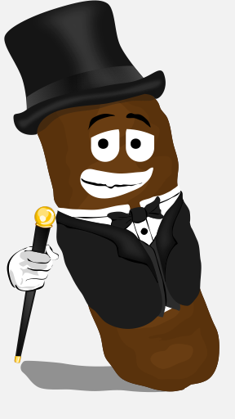
Why become a Shitzholder?
The Shitz will make you laugh until you shit!
You get to permanently name your freshly minted Shitz.
You can join a community of Shitzholders.
You get one vote for every Shitz NFT you mint to choose the direction of the project.
You get commercial rights to use, sell, and profit from your Shitz!
You get vote to support gastrointestinal disease charities.
You get giveaways, contests, and future Shitzy projects.
You get toilet drops of future generations of Shitz NFTs.

Slide 4
Why become a Shitzholder?
4,444 Unique Shitz with over 200 traits
60% Males and 40% Females
Every Shitz costs 1 SOL.
You can buy up to 10 Shitz per transaction.
Additional NFT Benefits will be released as we reach Roadmap Milestones

Slide 5
Roadmap Milestones
10% 25% 50% 75% 100%
Minting Begins 4/4/22
4:44 pm
Minting in Progress
Minting Complete
Shitz Breed!
Merchandise Store Opens!
2nd Vote/Donation
2nd Discord giveaways
3rd Vote/Donation
3rd Discord giveaways
1st Vote/Donation for Charity
1st Discord NFT/Solana giveaways
4th Vote/Donation
4th Discord giveaways

Slide 6
What are the Rarities and Types of Shitz?
Legendary
Big Shitz: These Shitz are kings and queens, politicians, celebrities, and business titans. They wear the finest clothes and accessories. They can be composed of precious metal or gemstone. They drive hot cars, drink top-shelf liquor (Shitzkey), smoke the finest cigars, and are usually found at the most happening places in Shitzville. They all hold positions of power in Shitziety. The Big Shitz have it all, and don’t really care about the other Shitz in Shitzville.

Slide 7
What are the Rarities and Types of Shitz?
Super Rare
Shitz-Outta-Luck: If the Big Shitz are at the top, then these Shitz are at the bottom of the Shitzpile. The Shitz Outta Luck are the poorest and unluckiest Shitz in Shitzville. They wear cheap clothes and live in low-income apartments, shacks, trailers, or out on the street. They like to accessorize, but they resort to cheaper items and home-made bling. They drink Shitzy cola, Shitz Beer, or Wine Shitzer. They hang out in bars, street corners, trailer parks, and parking lots. The Shitz-Outta-Luck survive day-by-day, so many of them are sad, angry, or are just fresh out of give-a-shit.

Slide 8
What are the Rarities and Types of Shitz?
Super Rare
Up-Shitz-Creekers: The Up-Shitz-Creekers live beyond the outskirts of Shitzville and live mostly solitary lives in No-Shitz-Land. They are preppers and survivors living off the grid. They dress in comfortable and practical clothes and carry tactical gear, weapons, and tools for survival in the wilderness. They live off the land, so you may see undigested Shitzberry pits in these Shitz. Most of them grew tired of dealing with the same old Shitz every day. They are happy with the arduous solitary lifestyle they have chosen.

Slide 9
What are the Rarities and Types of Shitz?
Super Rare
Get-off-the-Pot Shitz: These Shitz are thankfully few in number. These Shitz are indecisive young Shitz. They should be acting like adult Shitz but instead continue to act like little Shitz. Some still live at home with their parShitz. Others can’t seem to figure out what their purpose os in Shitzville. They work at odd jobs because they haven’t chosen careers. Some are still in school, staying in “safe” relationships, but never committing to anything or anyone.

Slide 10
What are the Rarities and Types of Shitz?
Super Rare
Shitztormz: The Shitztorms are very bad Shitz. Where they go, trouble follows. They are violent criminals. They have antiShitzal shitzonalities. Fortunately, they are super rare. They commit all types of crimes.

Slide 11
What are the Rarities and Types of Shitz?
Rare
Shitz Kickers (rare): The Shitz Kickers live on the outskirts of Shitzville, really in the country. Shitz Kickers can have any type of occupation, but most of them are farmers, ranchers, cowboys and cowgirls, and oilers. They can have variable social status and wealth. Some are owners, and some are workers. Because of their easy access to fresh vegetables, it is not uncommon to see undigested corn kernels and other vegetarian ruffage in these Shitz.

Slide 12
What are the Rarities and Types of Shitz?
Rare
Give-A-Shitz: The Give-A-Shitz are the lifeblood of Shitzville. They make the Shitz turn. They are physicians, nurses, police officers, firefighters, social workers, teachers, veterinarians, and paramedics. These Shitz really care about all the other Shitz, sometimes to their own detriment. They don’t go out for fun too much because they are always working. That’s why they are usually seen wearing their work clothes. Shitzville would go to shit without them.

Slide 13
What are the Rarities and Types of Shitz?
Rare
Happening Shitz: These Shitz are very cool and interesting Shitz. They are artists, musicians, actors, daredevils, writers, comedians, magicians, chefs, fashion designers, and professional athletes. These Shitz are The Shit! They bring joy and entertainment to the other Shitz in Shitzville!

Slide 14
What are the Rarities and Types of Shitz?
Rare
Hot Shitz: These Shitz are glorious specimens to behold! They are lean, shapely, voluptuous (females), brawny (males), and all the other Shitz just want to fuck the Shitz out of them. Some of them train hard while others hardly train but still got it where it counts. The Hot Shitz look real good dressed or undressed and everything in between. You know what I mean!

Slide 15
What are the Rarities and Types of Shitz?
Rare
Bat Shitz: These Shitz have eccentric personalities. Some are even certifiably insane. None of them are dangerous, but they do peculiar and outrageous things. Bat Shitz may be identifiable by bizarre facial expressions, odd clothing color combinations, or doing strange things in strange places. Shitzville would be a dull place without them.

Slide 16
What are the Rarities and Types of Shitz?
Rare
Tough Shitz: These Shitz don’t take any shit! They are badass and like to kick ass. A bar room brawl is their idea of a good time. They can be motorcycle gang members, construction workers, boxers, or wrestlers. You don’t want to mess with one of these Shitz. They’ll kick the shit out of you!

Slide 17
What are the Rarities and Types of Shitz?
Common
Jack Shitz and Jane Shitz: These everyday Shitz are the salt of the earth. They have blue collar and grey collar occupations. They enjoy many different leisure activities. The Jack and Jane Shitz are not only the most common Shitz but also are the most diverse Shitz. They can appear almost anywhere because no matter what the event or location, Jack and Jane Shitz are there doing the necessary work behind the scenes. Shitzville would fall to pieces without them.

Slide 18
Meet the Team
The Cryptonaut (Founder): The Cryptonaut is the founder of Cryptonaut Holdings, LLC, and the visionary of The Shitz. The Cryptonaut has been an emergency physician (Give-a-Shitz) for over 20 years. He is also an entrepreneur, cryptoasset investor/ enthusiast, martial artist (Tough Shitz), and backyard farmer (Shitz Kicker). Many people think The Cryptonaut is Bat Shitz, but he proudly accepts that as a badge of originality. We all have unique God-given qualities, talents, and purposes to be cultivated and shared with the world.

Slide 19
Meet the Team
CryptoDoc (Investor/Advisor): CryptoDoc has been a surgeon (Give-a-Shitz) for over 20 years, which is how long he’s been friends and business partners with the Cryptonaut. CryptoDoc is also an entrepreneur, cryptoasset investor/enthusiast, and martial artist (Tough Shitz). CryptoDoc introduced the Cryptonaut to NFTs in September of 2021 with the purchase of some Ethereans Official. Now CryptoDoc owns a Bored Ape (BAYC) which makes CryptoDoc a Big Shitz!

Slide 20
Meet the Team
Dr. SOL (Investor/Advisor): Dr. SOL has been a surgeon (Give-a-Shitz) for over 20 years, which is how long he’s been friends and business partners with CryptoDoc and the Cryptonaut.
Insert the other members of the team in the same format.

Slide 21
FAQs
How much do The Shitz cost?
The Shitz will be available to mint for 1 SOL each.
Is there a limit to how many Shitz I can mint?
You can mint as many Shitz as you want with a maximum of 10 per transaction.

Slide 22
FAQs
When can I mint?
The Whitelist mint begin on April Fools’ Day at 4:44 pm EST/ 9:44 UTC The public minting will begin on 4/4/22 at 4:44pm / 9:44 UTC.
Where can I mint?
Minting will ONLY be accessible at https://theshitz.io – double-check the URL to ensure it’s correct before proceeding with minting!

Slide 23
FAQs
Which Solana Wallets will be supported?
You’ll need a Solana wallet to purchase and manage your Shitz NFT collection, we recommend using one of the following wallets: https://phantom.app/ OR https://www.sollet.io/
How many Shitz will be reserved for Giveaways and Marketing?
We will reserve 100 Shitz NFTs for giveaways and prominent influencers to build the community and raise awareness leading-up to the mint.

Slide 24
FAQs
How many attributes do The Shitz have?
There are over 200 attributes covering backgrounds, body hues, faces, hair, outfits, hand gestures, and accessories.
Will The Shitz have a Rarity System?
Yes. As soon as all Shitz have been minted, we’ll release a chart to show the variation in rarity from common to legendary features, including everything from dark brown Shitz to Shitz of made of gold!

Slide 25
FAQs
Will I be able to trade The Shitz on a secondary market?
Our secondary market will be accessible via Solanart, DigitalEyes, and Solsea NFT marketplaces immediately after launch. Our Discord community will also have a marketplace channel reserved for trading.
Do I own the rights to my Shitz NFT?
As the owner of a Shitz NFT, you’ll have full commercial rights to use, sell, and profit from it as long as you acknowledge Cryptonaut Holdings and HODL Enterprises as the original creators of The Shitz NFT collection!

Slide 26
FAQs
Will there be Resale Royalties?
A 5% commission will be applied to all resales. We will be using these funds for future research and development of The Shitz.

